Slide 1
ARTIFICIAL INTELLIGENCE • MEDICAL IMAGE SEGMENTATION
ACADEMIC YEAR 2026
Brain Tumor Segmentation Using MRI
A Comparative Study of U-Net and SegFormer Architectures
Evaluating scratch CNN baselines, ImageNet-pretrained ResNet34 encoders, and hierarchical Vision Transformers on 3,929 clinical brain MRI scans.
PREPARED BY
INSTITUTION
Ahmed Abdullah Ibrahim | Elsayed Abdul Sattar Elsayed
Faculty of Artificial Intelligence, Kafr El Sheikh University

Slide 2

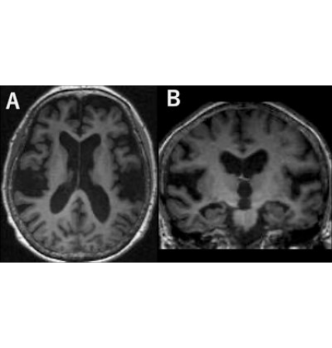
01 • CLINICAL MOTIVATION & SCOPE
Problem Statement & Objectives
Core Diagnostic Challenge
Manual MRI boundary delineation is time-intensive and subject to inter-observer variability. Automated systems must segment small tumors while avoiding false positives on healthy scans.
Baseline Benchmark: Train 2D U-Net architecture from scratch.
Transfer Learning: Evaluate ImageNet-pretrained ResNet34 encoder.
Vision Transformer: Compare lightweight SegFormer-B0 model.
Leakage Prevention: Enforce strict patient-level data splitting.
Prototype Deployment: Build interactive Streamlit inference tool.

Slide 3
02 • DATASET AUDIT
Dataset Scale & Class Distribution
3,929
110
65.05%
2.95%
Matched MRI & Mask Pairs
Unique Patient Folders
Empty Masks (2,556 Scans)
Mean Tumor Pixel Area
Positive Tumor Masks: 1,373 Images (34.95%)
Empty Background Masks: 2,556 Images (65.05%)
Small Target Footprint: Tumor pixel ratios range from 0.000107 to 0.120987 (SD: 0.02334), demanding strict False Positive Rate control.

Slide 4
03 • DATA LEAKAGE PREVENTION
Patient-Level Split Audit
Dataset Split | MRI Images | Patients | Positive Masks | Empty Masks
Training Set | 2,750 | 77 | 915 | 1,835
Validation Set | 618 | 16 | 234 | 384
Testing Set (Split Audit) | 561 | 17 | 224 | 337
Total Audited Dataset | 3,929 | 110 | 1,373 | 2,556
Zero Patient Overlap: Slices from the same patient never cross splits.
Final Test CSV Subset: 523 Samples (173 Positive / 350 Empty)

Slide 5
04 • DATA ENGINEERING
Preprocessing & Tensor Validation Pipeline
STEP 01
STEP 02
STEP 03
STEP 04
Grayscale Load
256 × 256 Resize
Unit Scaling
Tensor Packing
Single-channel intensity extraction
Nearest-neighbor mask interpolation
Float32 normalization to [0, 1]
Binary labels {0, 1} verified
SegFormer Input Adaptation
3-Channel ImageNet Norm
Validated Image Tensor
[Batch, 1, 256, 256]

Slide 6



05 • DEEP LEARNING ARCHITECTURES
Evaluated Segmentation Models
U-Net from Scratch
Pretrained U-Net
SegFormer-B0
Randomly initialized encoder-decoder baseline.
ImageNet-pretrained ResNet34 residual backbone.
Lightweight hierarchical Vision Transformer.
Threshold: 0.8
Threshold: 0.6 • Selected
Threshold: 0.5

Slide 7


06 • EXPERIMENTAL PROTOCOL
Evaluation Metrics & Optimization Setup
Empty-Mask False Positive Rate (FPR)
Positive Dice Similarity Coefficient
FPR_empty = False Positive Empty Scans / Total Empty Scans
Averaged strictly over non-empty ground-truth tumor scans.
Quantifies spurious tumor predictions across 350 healthy test scans.
Positive Intersection over Union (IoU)
Baseline Training Configuration
Loss & Optimizer: Dice + BCE Loss with AdamW (LR: 0.001)
Measures strict spatial overlap ratio on positive tumor slices.
Schedule & Epochs: ReduceLROnPlateau, 20 Epochs, Seed 42
Model Selection: Best validation Positive Dice checkpoint

Slide 8
07 • KEY EXPERIMENTAL FINDING
Pretrained ResNet34 Feature Advantage
PRETRAINED U-NET (RESNET34) AT 0.6 THRESHOLD
0.7271
Highest Positive Dice Score (+31.22% over Scratch Baseline)
Transfer learning with ImageNet residual weights boosted Positive IoU from 0.3213 to 0.6213 while cutting Empty-mask FPR by more than half.

Slide 9
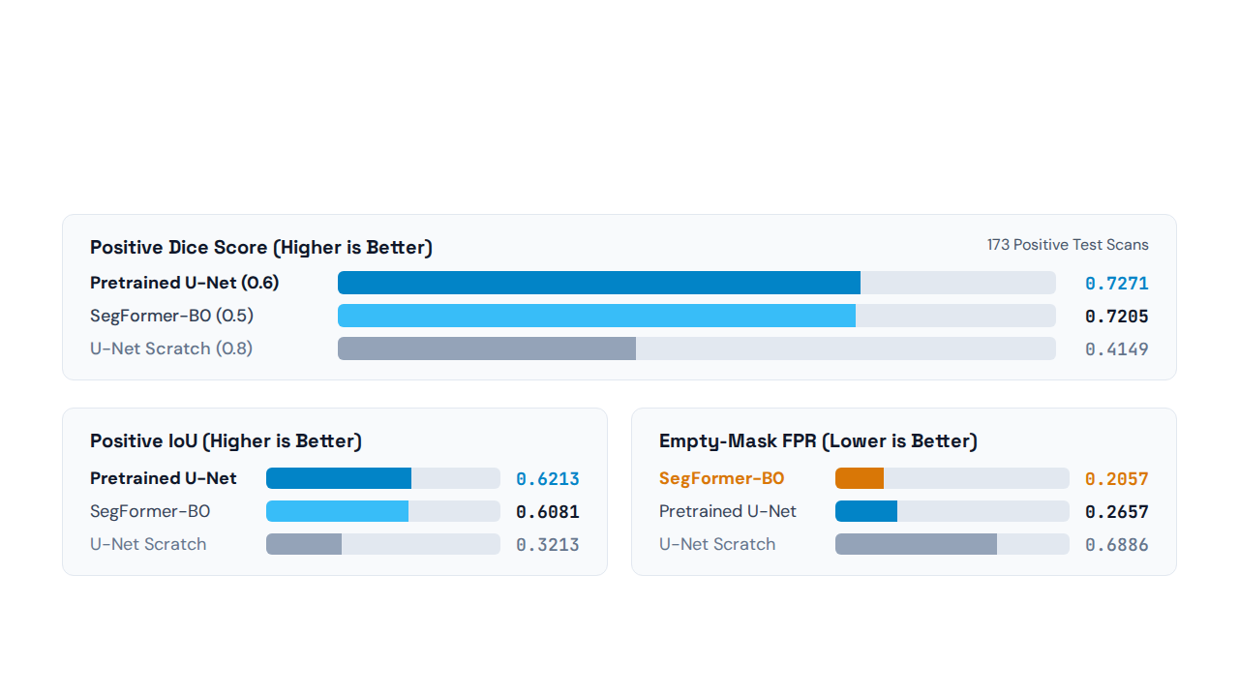
08 • BENCHMARK RESULTS (523 TEST SAMPLES)
Final Quantitative Model Comparison

Slide 10


09 • VISUAL INSPECTION & FAILURE MODES
Qualitative Error Analysis
Accurate Boundary Overlap
Under-Segmentation
High spatial agreement on distinct lesions.
Partial mask coverage on low-contrast margins.
Over-Segmentation
Empty-Mask False Positives
Predicted spill beyond ground-truth tumor contour.
Spurious predictions minimized in SegFormer-B0 (0.2057).

Slide 11

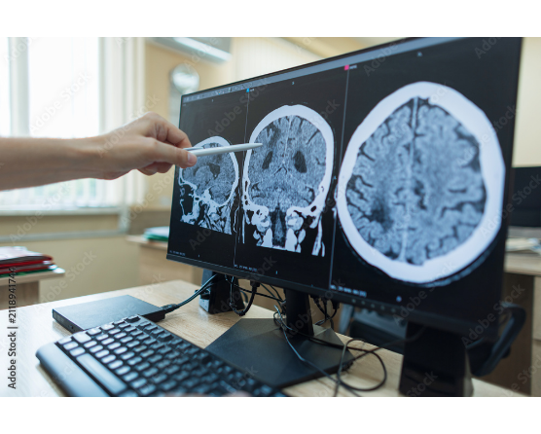
10 • INTERACTIVE DEPLOYMENT
Streamlit Application Prototype
Powered by the exported Pretrained U-Net (ResNet34) checkpoint for real-time 2D slice inference and mask visualization.
1.
MRI Upload & Grayscale: Converts uploaded scan to 256×256 float tensor.
2.
Sigmoid & Threshold: Applies 0.6 probability threshold to logits.
3.
Visual Overlay: Displays original MRI, binary mask, and tumor overlay.
4.
Quantitative Export: Computes pixel area percentage and mask download.
Academic Research Prototype • Not for clinical diagnostic decisions.

Slide 12
11 • CONCLUSION & FUTURE DIRECTIONS
Advancing Automated Brain MRI Analysis
Pretrained ResNet34 U-Net delivered top overlap (0.7271 Dice, 0.6213 IoU), while SegFormer-B0 achieved superior specificity on tumor-free scans (0.2057 Empty-mask FPR).
Current Limitations
Future Roadmap
Single-dataset evaluation, 65% empty-mask imbalance, and non-zero false-positive rates on healthy scans.
CNN-Transformer ensembles, uncertainty estimation, boundary metrics, and multi-center external clinical validation.
Thank You • Questions & Discussion

Slide 13


Image Sources
https://img.auntminnie.com/mindful/smg/workspaces/default/uploads/2026/10/2026-10-13-radiology-brain-mri-desh.bwE1OZEnTM.jpg?auto=format%2Ccompress&fit=max&q=70&w=400
Source: www.auntminnie.com
https://as2.ftcdn.net/v2/jpg/21/18/94/17/1000_F_2118941744_eqjGFGkMdx8i9ercczK9p8gHUwal4j4M.jpg
Source: www.posters.es

